Slide 1
A Typical SLA
Conditions |  | First Response Within | Case Resolution Within
Customer Type | Case Priority
Premium/Corporate | High | 1 business hour | 1 business day
Premium/Corporate | Not High | 4 business hours | 2 business days
Standard | - | 1 business day | 5 business days
Send Email to CSR/CSM;
Update Case – Set SLA met to No
Send Email to CSR/CSM;
Update Case – Set SLA met to No
Send warning email to case owner
Send warning email to case owner
Case Created
First Response By
Case Resolved By

Slide 2
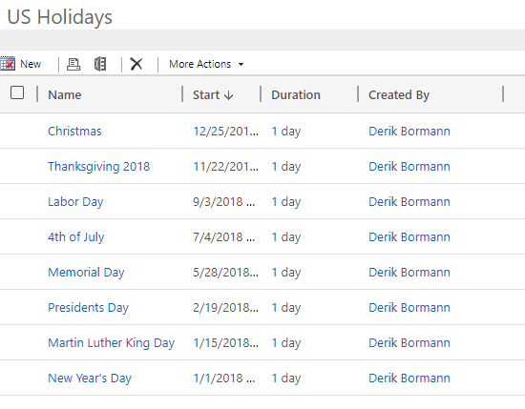

Slide 3
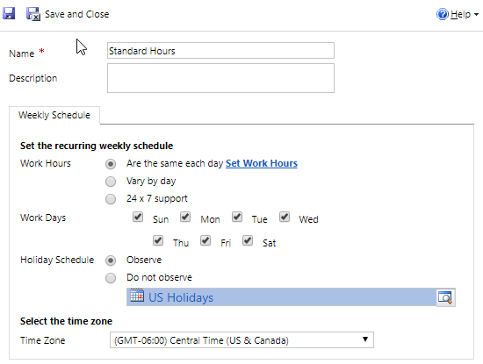
Allows for defining working hours including breaks, lunch, etc.

Slide 4
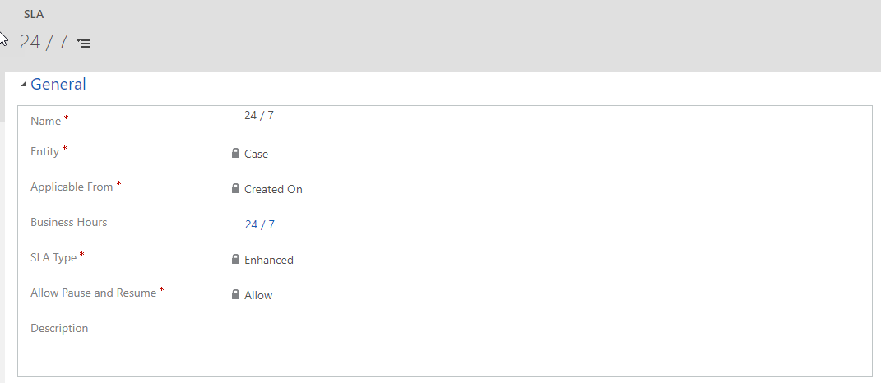

Slide 5



Support Contract SLA
KPI = First Response By
Condition: Service Level = Gold
First Response = 1 Hour
KPI = Resolve By
Condition: Service Level = Gold
Resolve Case = 4 Hours
Gold Customer SLA Details
KPI = First Response By
Condition: Service Level = Silver
First Response = 2 Hours
KPI = Resolve By
Condition: Service Level = Silver
Resolve Case = 1 Day
Silver Customer SLA Details
KPI = First Response By
Condition: Service Level = Bronze
First Response = 4 Hours
Bronze Customer SLA Details
KPI = Resolve By
Condition: Service Level = Bronze
Resolve Case = 2 Days

Slide 6
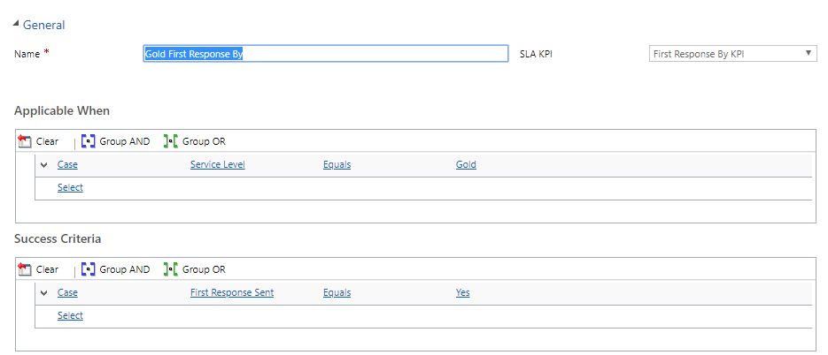
All KPIs defined for the entity will be available to select.
Both applicable when and success criteria provide the ability to define multiple AND / OR items.

Slide 7
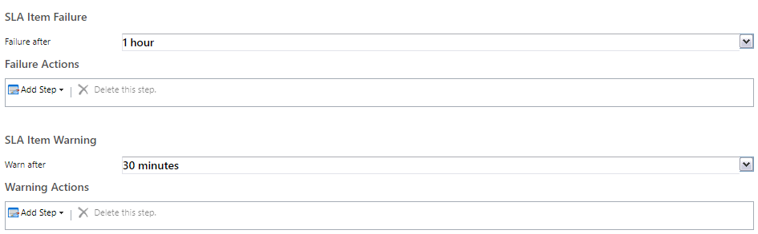

Slide 8
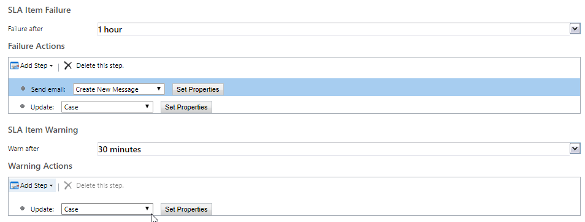

Slide 9
Multiple SLA Items
Gold Detail Item
Service Level = Gold
Silver Detail Item
Service Level = Silver
Bronze Detail Item
Service Level = Bronze
Failure = 1 Hour
Warning = 30 Minutes
Failure = 2 Hours
Warning = 1.5 Hours
Failure = 3 Hours
Warning = 2.5 Hours

Slide 10
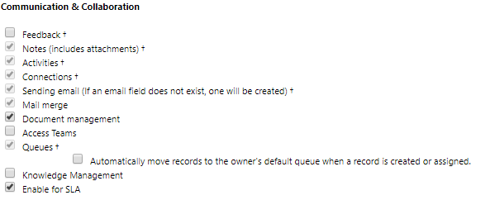
Check Enable for SLA, then save and publish your changes.

Slide 11
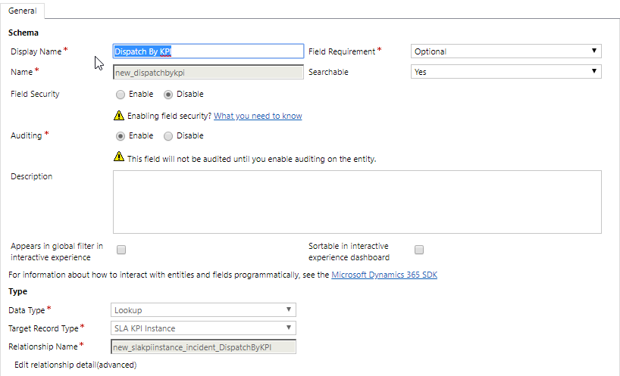
Data Type must be set to Lookup and Target Record Type should be set to SLA KPI Instance.

Slide 12
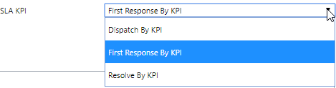
New KPI is available to select from the SLA KPI field on the SLA Detail Item.

